Slide 1
Implementing Carbon Capture and Storage at Existing Gas Plants
Tackling the challenges
Patrick Walker
September 2024

Slide 2
Overview
Carbon Capture and Storage at gas processing facilities
Hazards profile of a gas processing facility
Carbon Dioxide (CO₂) hazards introduced by carbon capture and storage
Major incidents involving carbon dioxide
Case study illustrating the significant hazard ranges introduced by CO₂ releases from future CCS operations

Slide 3
Carbon Capture and Storage
Achieving greenhouse gas emission targets will require mitigation measures to remove (capture) carbon dioxide (CO₂) from process vent systems in many existing use situations.
Carbon Capture and Storage (CCS) aims to prevent CO₂ generated by processing facilities from being released into the atmosphere
CCS involves capturing CO₂, transporting it (usually by pipeline), and then storing it underground (typically in depleted gas reservoirs).
Capture and compression for transportation is typically conducted on-site at an existing processing facility.

Slide 4
Existing plant with future CCS operations
Capture
CO₂
CO₂ Transport Pipeline
Raw Gas
Injection / Storage
Gas Processing Area
CCS Area

Slide 5
Existing Hazards
Hazardous materials involved in gas processing are mostly flammable primarily presenting a fire and explosion hazard
Toxic components of raw gas are only present in relatively small quantities
Toxic effects of releases only likely to affect those in the immediate area
Components of raw gas removed in processing include toxic materials such as CO₂ and hydrogen sulphide
Whilst there is operational awareness of these toxic hazards, the safety case will typically be focussed on the major fire and explosion hazards.

Slide 6
The toxic hazard introduced by CCS
CCS incorporates handling of significant amounts of pure carbon dioxide in dense-phase (supercritical) or liquid state:
Significant amounts: throughput in millions of tonnes per annum (Mtpa)
Supercritical/liquid phase requires high-pressure – megapascals (MPa).
A major release of pure CO₂ at these operation conditions presents a serious toxic hazard. The facility risk profile is significantly changed with the introduction of CCS
Furthermore, the unique thermodynamic behaviour of CO₂ released at these conditions (i.e. supercritical or liquid) can lead to significantly large hazard ranges as the release is likely to remain at ground level.

Slide 7
CO₂ Toxicity
CO₂ is considered mildly toxic as it is not harmful at low concentrations
Not harmful at atmospheric concentrations (~0.03 vol%).
Toxic at higher concentrations with effects depending on concentration and exposure duration. For example,
Harm Threshold: Adverse health effects exposure limit of 3 vol% for 15 minutes
Injury Threshold: Injury potential after exposure to 4 vol% for 30 minutes
Fatality Threshold: Fatality potential after exposure to 7 vol% for30 minutes
Immediate Fatality: Possible immediate threat to life via asphyxiation at 50 vol%.

Slide 8
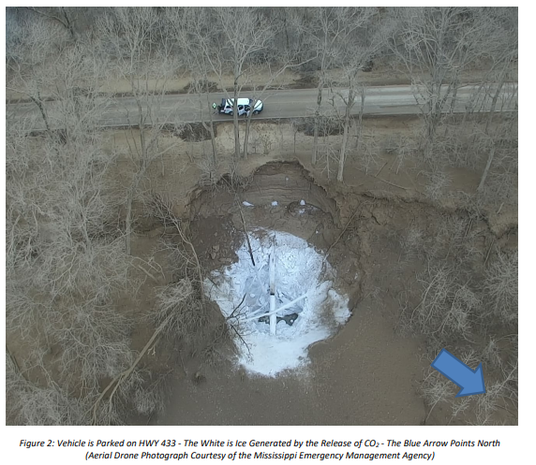
Denbury Gulf Coast Pipelines LLC CO₂ Pipeline Rupture
Pipeline ruptured, releasing liquid CO2 that vaporize at atmospheric conditions.
The weather conditions and unique site topography prevented the CO₂ vapour from dispersing, enabling it to flow towards a nearby town (Satartia).
Forty-five people sought medical attention at local hospitals. No fatalities.
US Department of Transportation, PHSMA, “Failure Investigation Report – Denbury Gulf Coast Pipelines LLC Pipeline Rupture/Natural Force Damage”, May 26, 2022.

Slide 9
CO₂ Release Characteristics
C. Spitzenberger (2023), “Carbon Dioxide Major Accident Hazard Awareness,” CEP, AIChE.

Slide 10
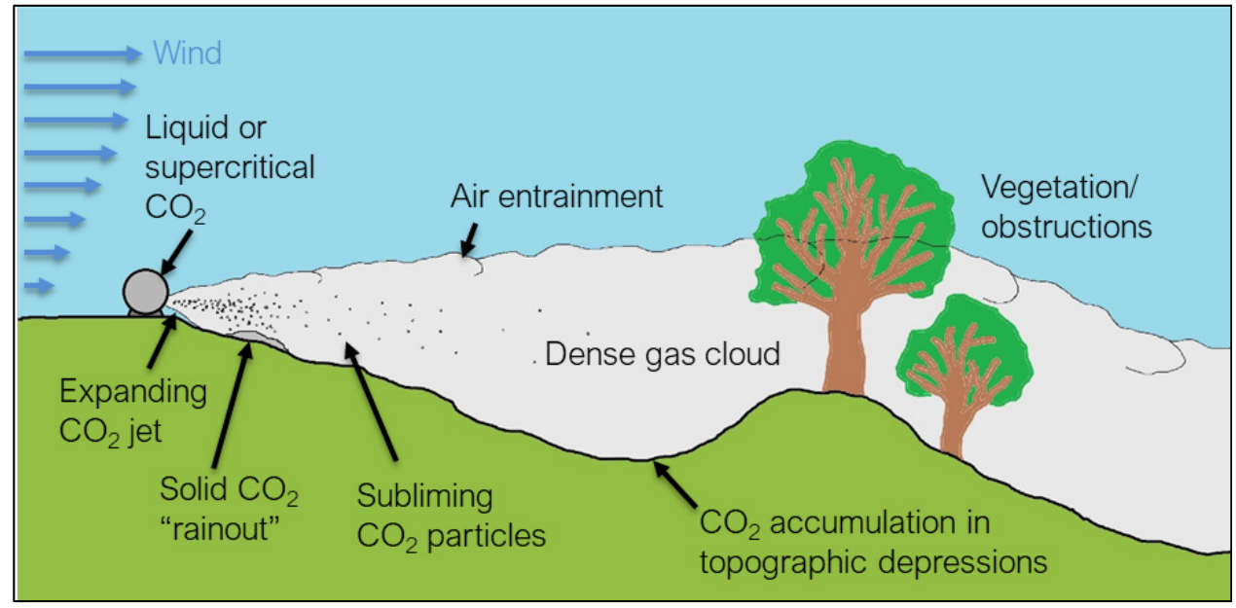
CO₂ Dispersion Characteristics
DNV (2022), “Advanced CO2 consequence modelling for safe CCS”.

Slide 11
CCS Major Incidents Hazards
CO₂ Major Incidents breaks down into the following key categories:
Source, the existing facilities
Capture, Compression
Transportation (i.e. pipelines)
Scenario 1: Raw Gas Source to Capture
50 mm release of raw gas from existing plant (i.e. 5 MPa, 30°C).
Composition of methane (~70%) with CO₂ (~30%)
Scenario 2: Compression / Transportation inlet
50 mm release of CO₂ from future compression facilities (i.e. 10 MPa, 30°C)

Slide 12
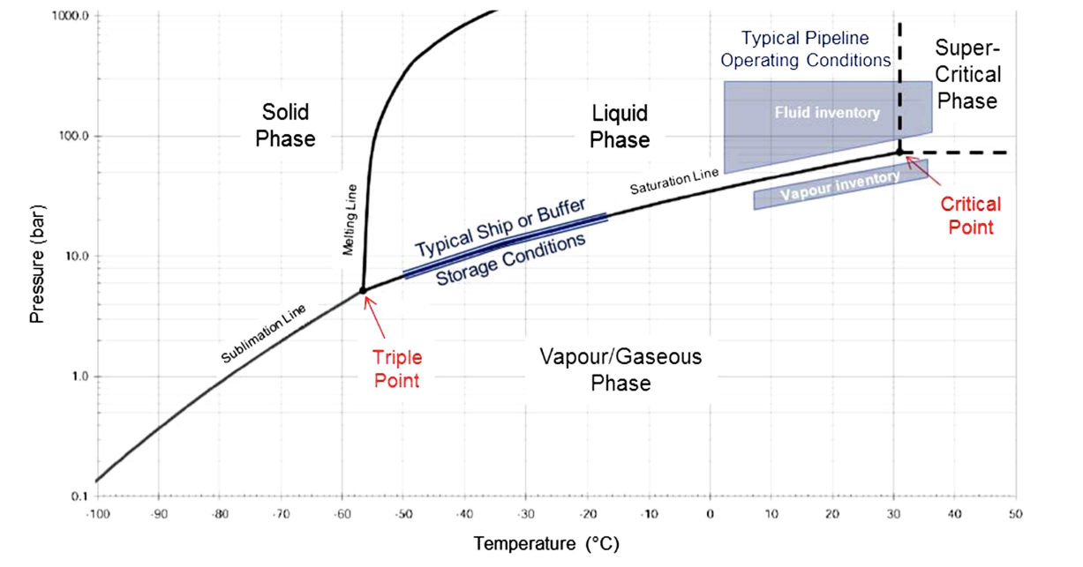
Typical Operating Conditions
Scenario 2
Scenario 1
DNV, “CO2 RISKMAN JIP, Guidance on CCS CO2 Safety and Environment Major Accident Hazard Risk Management, Level 3 – Generic Guidance”, Report No. I3IJLJW-2, 30 January 2013, Rev. 1 (Reissued 17 December 2021, Rev 3).

Slide 13
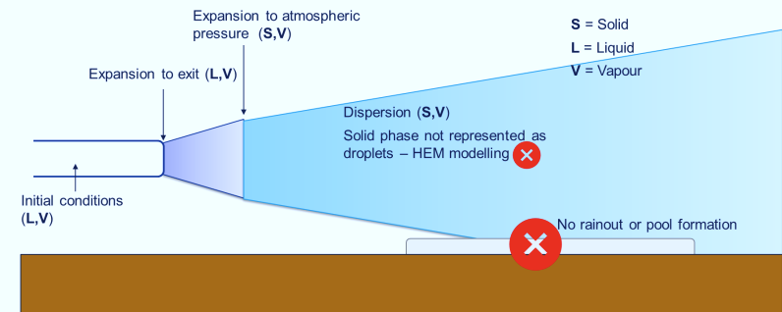
Modelling Approach
DNV Phast software for modelling with extension to handle the fluid-to-solid transition of CO₂
The effect of solids formation is considered in the modelling.
Dispersion model for horizontal releases validated against experimental data
CO2PIPETRANS JIP8.
No solid fallout.
Model parameters:
Scenario-specific process conditions
Typical day & stable night weather conditions
Potential toxic effects – Harm, Injury, Fatality & Immediate Fatality.
DNV (2022), “Application of Phast and Safeti to carbon dioxide consequences and risks”.

Slide 14
Scenario 1: Raw Gas to Capture
Extent of Flammable Envelope:
25 m
Extent of Injury Threshold:
6 m

Slide 15
Scenario 2: Compressed CO₂ to Transport
Extent of Injury Threshold – Side View:
110 m
Extent of Injury Threshold – Footprint (@1 m):

Slide 16
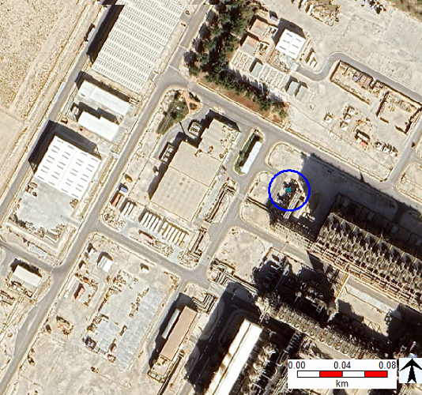
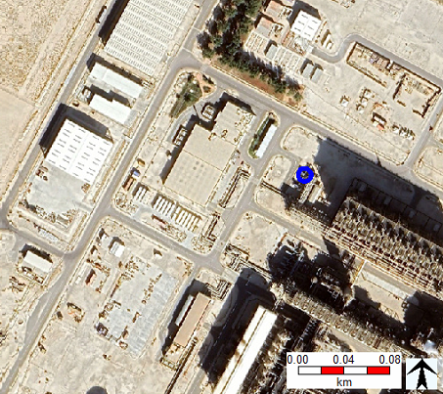
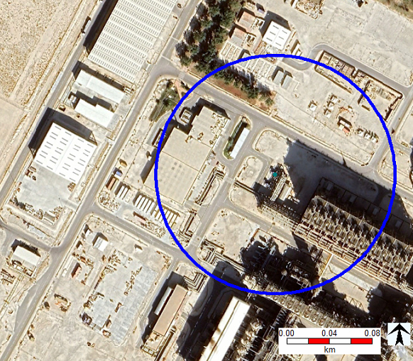
Comparison of Hazard Ranges
Scenario 1
Hazard Range
Scenario 2
Hazard Range
A CO₂ release from CCS facilities could impact a much larger, previously unaffected population.

Slide 17
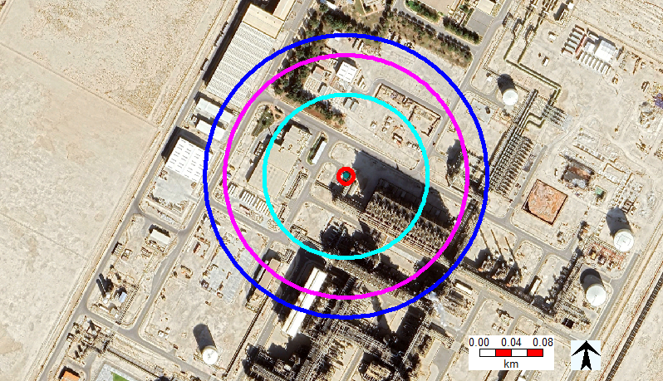
Impact on Surrounding Areas
175 m

Slide 18
Upgrading Emergency Response Plans
Update emergency response plans to incorporate strategy required in response to a CO₂ release
PPE different from that typically used
Respiratory protection to cope with the toxic risk
Leather gloves to cope with frostbite risk
Hearing protection from high-pressure releases
Training tailored to the specific needs of CO₂ releases
Understanding the constraints of respiration equipment and the time available
Enacting a buddy system so responders do not enter vapour clouds alone
Institutions are developing ER guidance to assist operators
Response to events like the Denbury incident, but applicable at site too
API tactical guidance in responding to a pipeline CO₂ release

Slide 19
Consider shelter-in-place capacity
Toxic hazards present different risk to personnel within buildings.
Toxic exposure potential for personnel in buildings surrounding the process buildings and perhaps beyond
New concepts introduced to operators and personnel alike
Considerations and adjustments for on-site buildings (e.g. RP 752)
In response to a toxic release, is sheltering in place or evacuating safer?
How long can I stay indoors before needed to exit?
What additional PPE personnel protective equipment does it require?
Are existing buildings capable of serving as effective toxic refuges?
Ensuring buildings are airtight: sealing windows, doors, and penetrations.
HVAC systems capable of shutdown.
Systems to notify personnel (indoor and outdoor) of air concentration levels.

Slide 20
Conclusion: CCS Triggers Toxic Thoughts 🤯
Releases pose a significant toxic hazard, distinct from traditional hazards at gas processing plants.
CO₂ used in large quantities combined with its unique physical properties increases the potential risk
CO₂ release scenarios could expose personnel to harmful concentrations in the plant and nearby areas.
May involve large numbers of people who were not previously exposed to plant hazards.
Insights can be used to update emergency response plans for potential CO₂ release impacts at CCS facilities.

Slide 21
Thank you
Notes:
Thank you so much for being here today for my presentation.
I still have a few minutes, so I’m happy to answer any questions you might have. Otherwise, it’s been a pleasure, thank you.

Slide 22
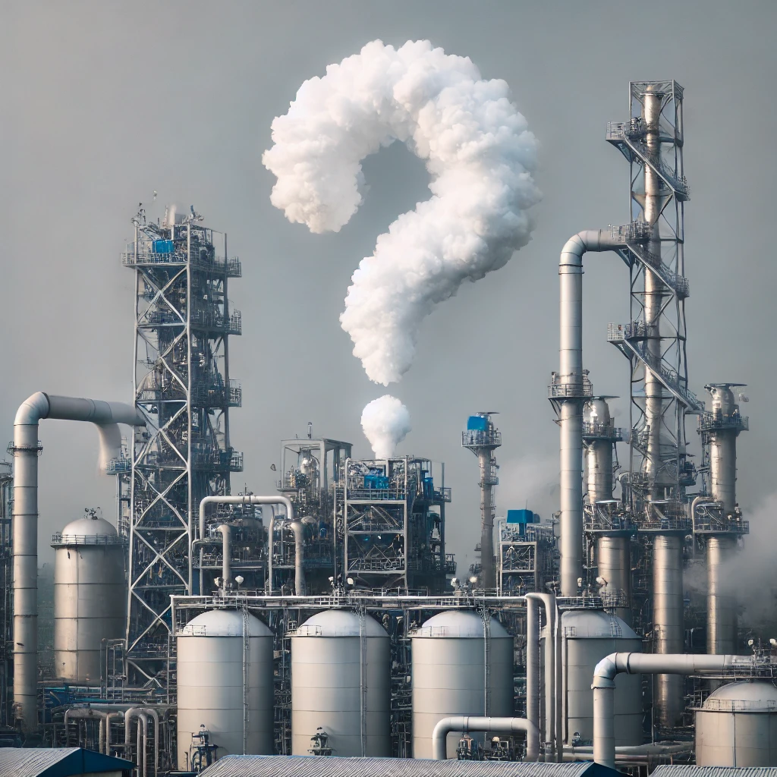
Questions?

